Slide 1
Alzheimer’s Disease Progression Analysis
A comprehensive exploration of key factors influencing Alzheimer's disease

Slide 2
Introduction
This analysis explores a dataset of 2,149 patients to identify key factors influencing Alzheimer’s disease. We examine demographic trends, medical history, cognitive function, and lifestyle factors that contribute to the disease progression.

Slide 3
Dataset Overview
- Number of patients: 2,149
- Number of variables: 35
- Key aspects analyzed: Age, Gender, BMI, Education, Medical History, Cognitive Scores
- No missing values detected

Slide 4
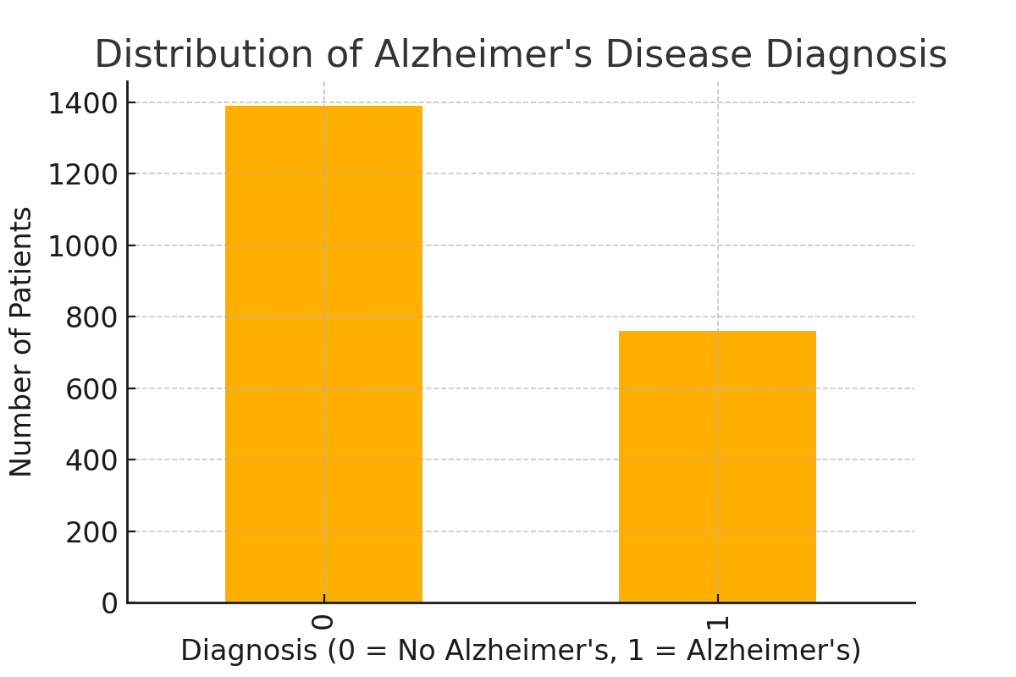
Alzheimer’s Disease Diagnosis Distribution

Slide 5
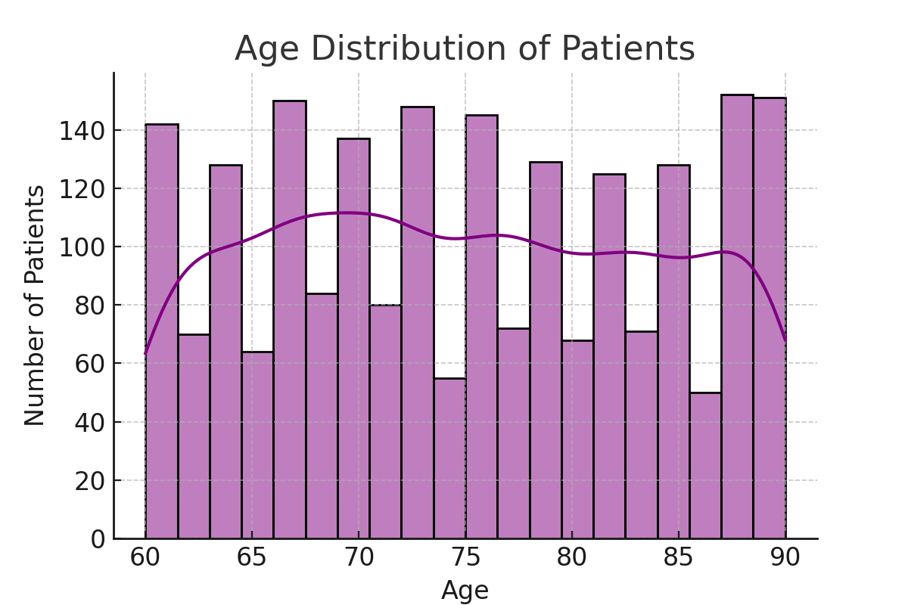
Age Distribution of Patients

Slide 6
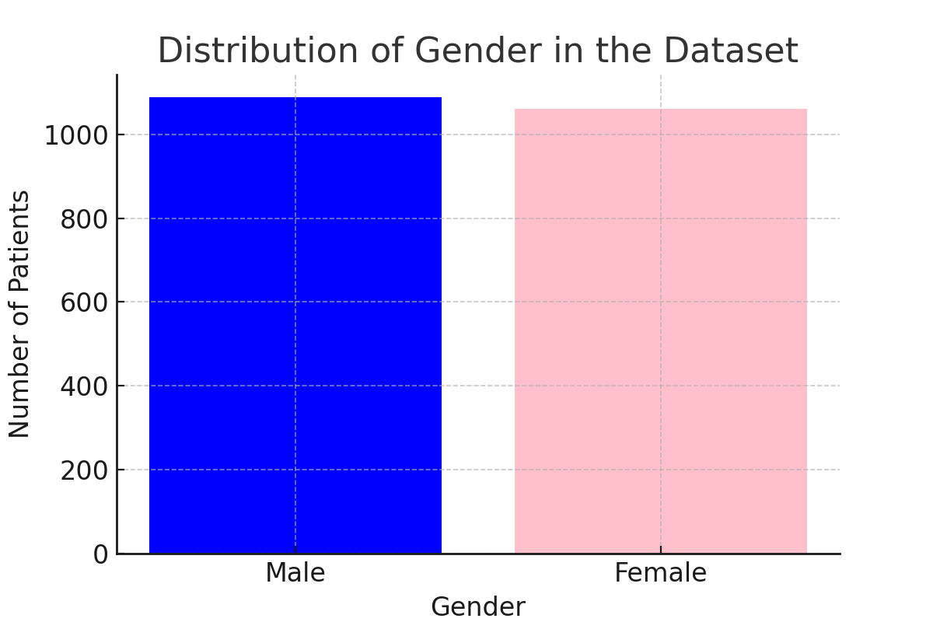
Gender Distribution

Slide 7
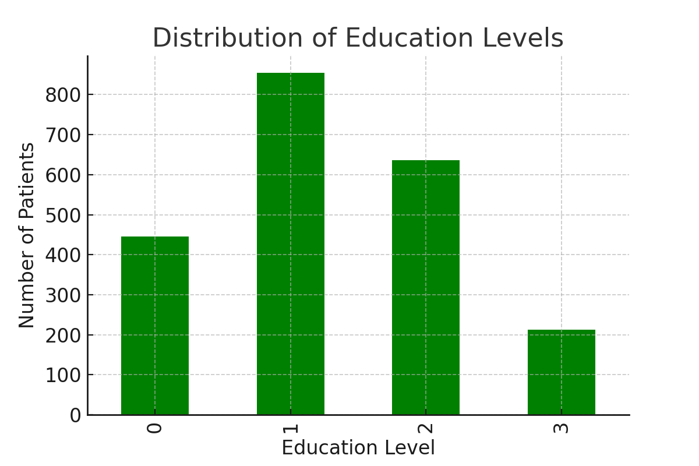
Education Level Distribution

Slide 8
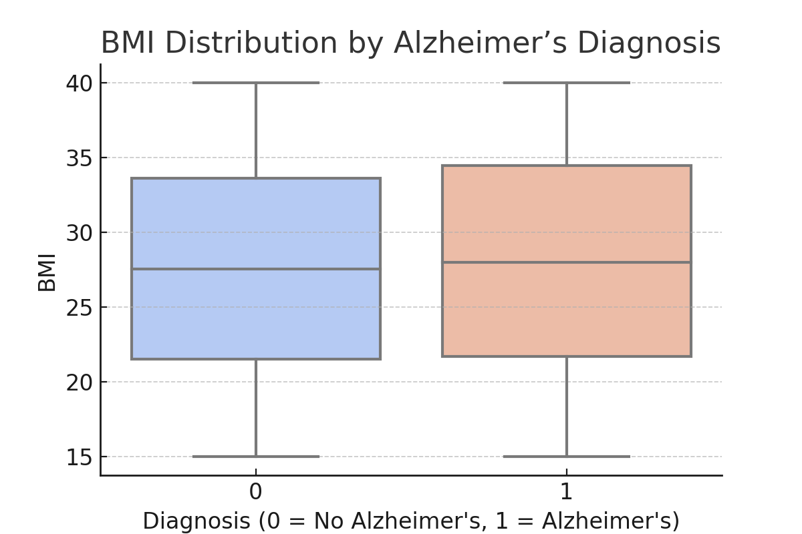
BMI Distribution by Alzheimer’s Diagnosis

Slide 9
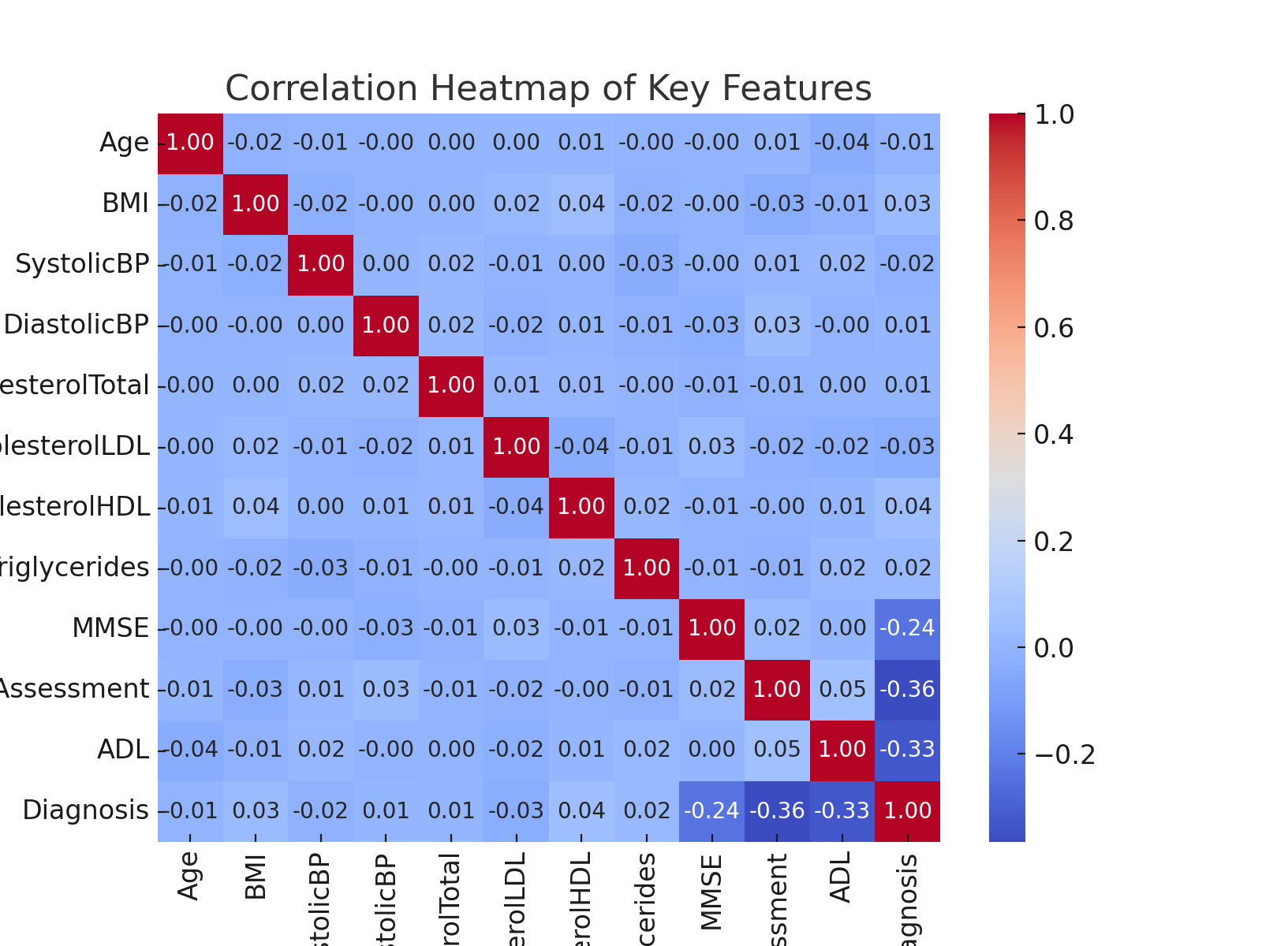
Correlation Heatmap of Key Features

Slide 10
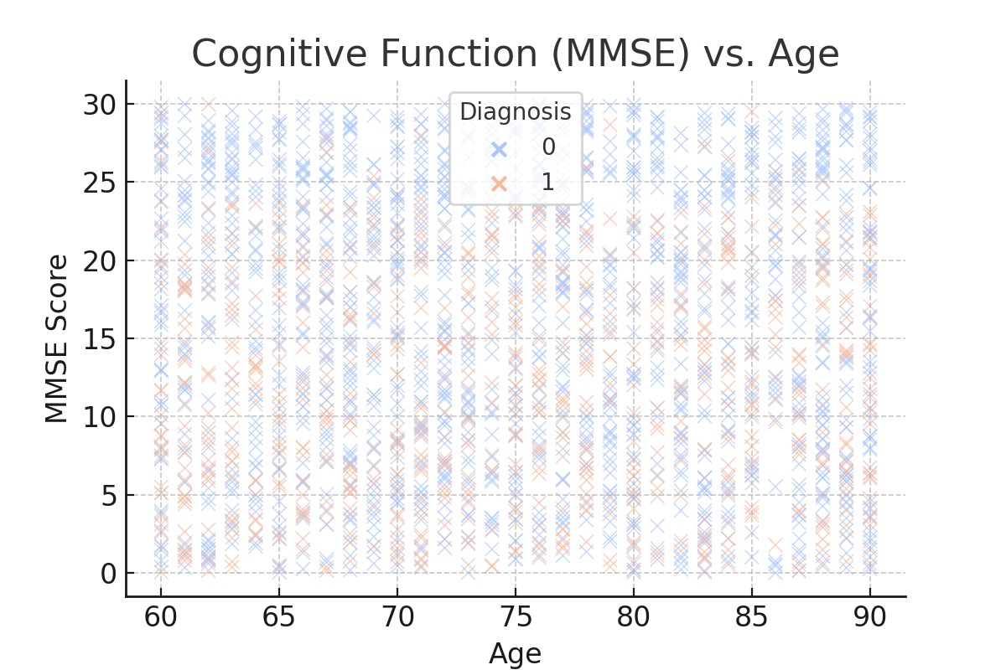
Cognitive Function (MMSE) vs. Age

Slide 11
Conclusion
- Alzheimer's diagnosis is prevalent in the dataset, requiring deeper analysis of risk factors.
- Age and BMI appear to have some impact on disease progression.
- Cognitive function, measured by MMSE, declines with age, especially in diagnosed patients.
- Further predictive modeling can help assess individual risk factors.

Slide 12
Medical Background on Alzheimer’s Disease
- **Definition**: Alzheimer’s disease is a progressive neurological disorder that leads to memory loss, cognitive decline, and behavioral changes.
- **Symptoms**:
- Early signs: Forgetfulness, confusion, difficulty completing tasks.
- Later stages: Severe memory loss, personality changes, difficulty speaking and walking.
- **Causes & Risk Factors**:
- Genetic predisposition (APOE-e4 gene)
- Age (major risk factor, most common in people over 65)
- Lifestyle factors (diet, exercise, smoking, alcohol consumption)
- Cardiovascular health (high blood pressure, diabetes, obesity)
- **Progression**: Alzheimer’s develops over several years, moving from mild cognitive impairment (MCI) to severe dementia.
- **Diagnosis**: Clinical evaluation, cognitive tests (MMSE), brain imaging, and biomarker analysis.

